Slide 1
Lecture 8
26th Nov 2022
News sharing and discussion
Dr. MRIDULA MISHRA

Slide 2
Unit 4
Performance Management System : performance management, performance planning, performance appraisal, potential appraisal, feedback and counselling
Compensation Management : types and theories of compensation, concept of wages, factors influencing compensation management, incentives and fringe benefits, employee engagement and retention

Slide 3
Learning outcomes
Students will be able to understand and learn
Performance Management System
performance management
performance planning
performance appraisal
potential appraisal
feedback and counselling

Slide 4
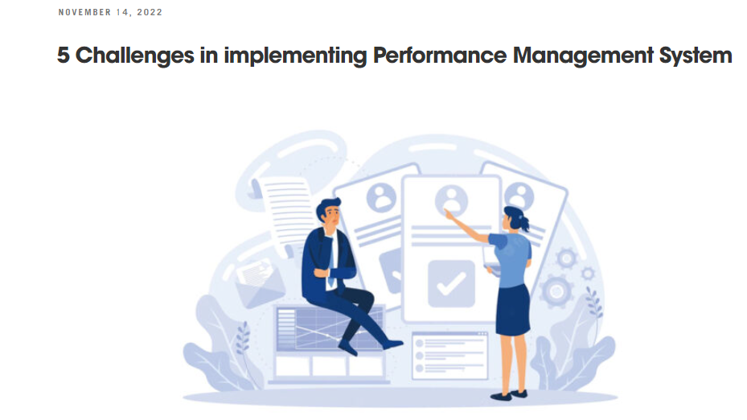
News
Customized Software
Goals & Objectives
Evaluation & Feedback
Rewards & Development
System Integration

Slide 5
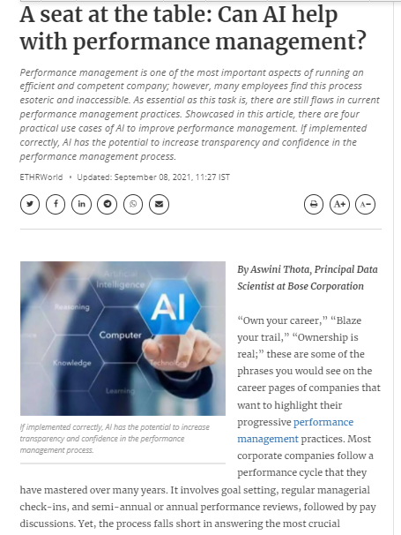
News
Notes:
A seat at the table: Can AI help with performance management?

Slide 6
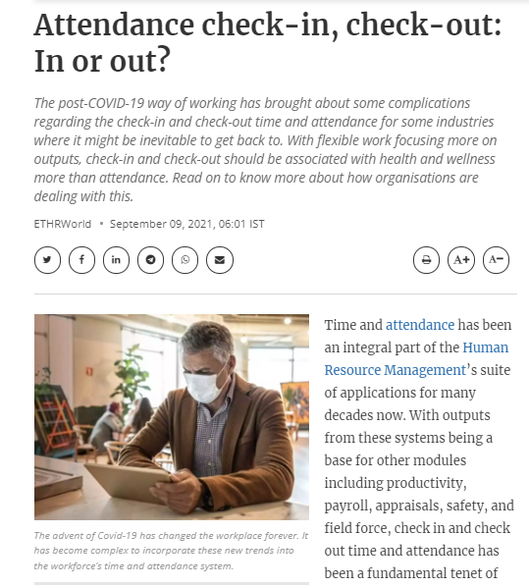
News
Notes:
Attendance check-in, check-out: In or out?

Slide 7
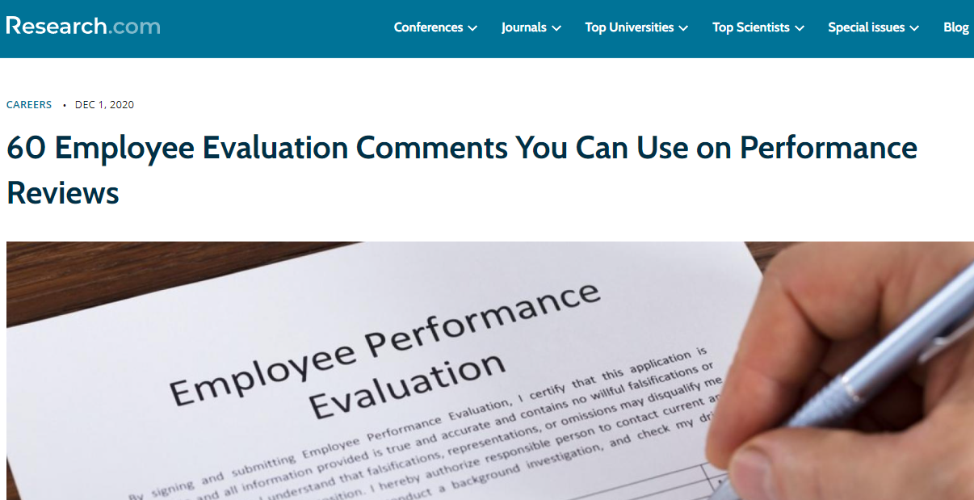
News
Notes:
https://research.com/careers/employee-evaluation-comments - 60 Employee Evaluation Comments You Can Use on Performance Reviews

Slide 8
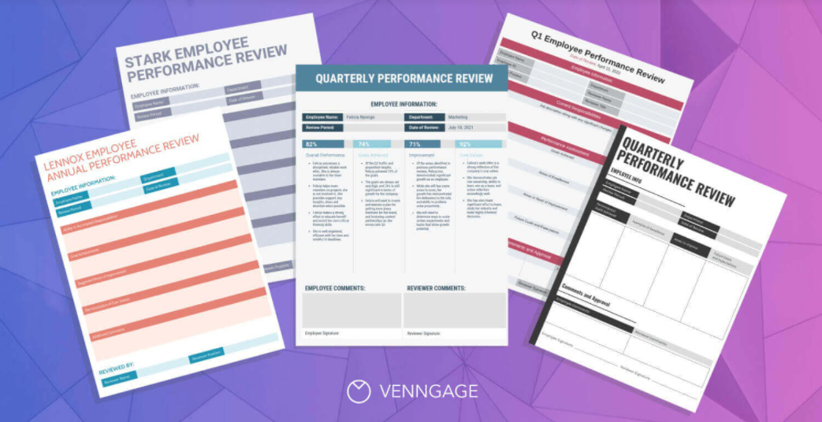
News

Slide 9
MCQs
......................... is a systematic and detailed analysis of jobs to identify job contents, the knowledge, skills and aptitudes required and the work behaviour.
Task analysis
Man power
Organisational analysis
Job analysis
Notes:
task analysis

Slide 10
MCQs
Under ............... method the trainee is placed on a regular job and taught the skills necessary to perform it.
on the job training
off the job training
vestibule training
in basket training
Notes:
on the job training

Slide 11
Important Links
https://www.youtube.com/watch?v=J_Qe9MMDAms -What it is & Why it's so important
https://www.youtube.com/watch?v=ZT2I2EQngN4 - Performance Management - Funny
https://www.youtube.com/watch?v=8ijBfprUNuQ -How to create a performance management system
https://www.youtube.com/watch?v=LC7bWCEtyHc Introduction to developing & managing performance management systems
https://www.youtube.com/watch?v=kHyelDJvsCI -How can managers give effective feedback?

Slide 12
Performance Management System
Performance management system is a total and integrated process comprising of goal-setting, training, evaluation and rewarding employees.
Performance Evaluation
Performance evaluation is an objective review and rating of an employee’s performance in comparison with the relative performance standards.

Slide 13
Objectives of Performance Management
To identify a performance gap
To provide a basis for promotion, transfer and termination
To aid in designing training and development programmes
To assist in wage and salary administration
To help in increasing employee effectiveness
To improve interpersonal relations
To identify employees’ grievances

Slide 14
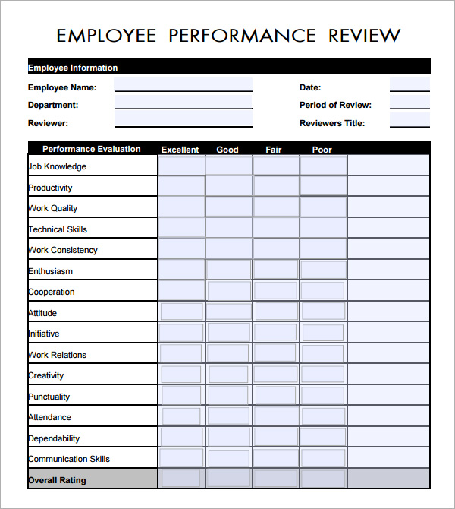

Slide 15
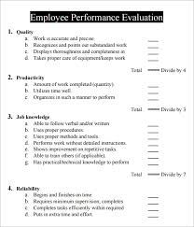

Slide 16
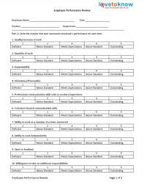

Slide 17
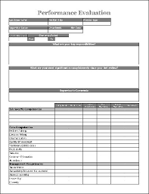

Slide 18
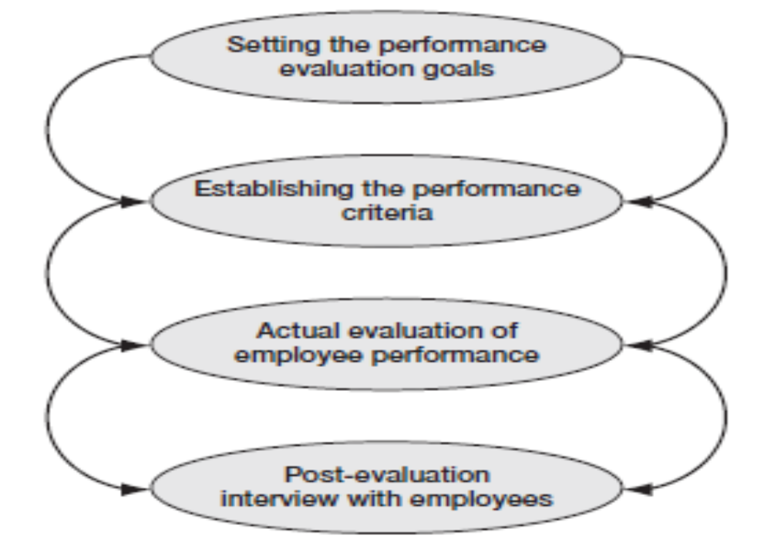
Process of Performance

Slide 19
Problems in Performance Appraisal
Absence of objectivity
Halo effects
Central tendency
Lenient attitude
Bias
Recency effects
Employee resistance

Slide 20
Steps to overcome the problems in the evaluation process
Proper training of the evaluators
Continuous evaluation
Determining the right tool for evaluation
Anticipating the possible problems in evaluation and developing their remedy

Slide 21
Performance Evaluation Methods
Checklist
Field Review
Confidential Report
Result-Based Evaluation System
Behaviourally Anchored Rating Scales (BARS) Method
360 Degree Feedback
Management by Objectives (MBO)
Rating Scales
Ranking Method
Paired Comparison
Forced Distribution
Forced Choice
Critical Incident
Essay Method
Cost–Benefit
Work Standard

Slide 22
https://www.sumhr.com/top-performance-appraisal-methods-startups-small-businesses/- The Top 10 Performance Appraisal Methods for Startups & Small Businesses

Slide 23
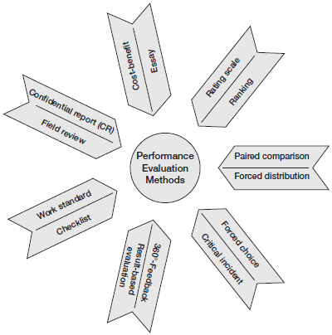
Performance Evaluation Methods

Slide 24
Rating Scales Method
In this method, employees are rated according to pre-specified factors.
Evaluators record their assessment of the performance of the employees on a rating scale.
A scale actually lists a group of traits and a range of performance expected for each trait.
The supervisor evaluates an employee by circling, in the evaluation form, a scale of each factor that best describes his or her performance.

Slide 25
Rating Scales Method
Attitude of employee towards his superiors, colleagues and customers
Regularity in the job
Extremely Excellent Poor
1 | 2 | 3 | 4 | 5 | 6 | 7 | 8 | 9 | 10
Extremely Excellent Poor
1 | 2 | 3 | 4 | 5 | 6 | 7 | 8 | 9 | 10

Slide 26
Ranking Method
In this method, each employee is ranked by the evaluator on the basis of his or her relative worth to the organization, as compared to other employees.
Each evaluated employee secures a place in a ranking order ranging from top most to the worst for selected characteristics.
The best employee in the list is ranked the highest, and the poorest one is at the bottom for the same traits.
Managers have to make evaluative decisions, such as who is the employee of the month, who gets a raise or promotion, and who gets laid off

Slide 27
Paired Comparison
In this method, two employees of a group are considered as a unit or pair.
On the basis of predetermined criteria, such as total performance, one employee is compared to another.
The process of comparing a pair of employees continues until all the employees have been compared.
Finally, the employee with the greatest number of favourable responses in inter-person comparison gets the highest ranking.

Slide 28
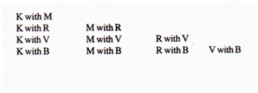
Paired Comparison
The number of possible pairs for a given number of employees is ascertained by the following formula:
N (N-1)/2
If the following five teachers have to be evaluated by the Vice Chanceller of a University:
Kumar (K), Mohapatra(M), Raul (R), Venkat (V), and Barman (B), the above formula gives 5 (5 -1) / 2 or 10 pairs.
These are:

Slide 29
Forced Distribution Method
In this method, the evaluator is forced to assign the employees to various performance categories like excellent, good, average, poor, etc., each with a predetermined percentage.
This method forces the weak managers to act against the poor performers.
However, it might affect the morale of the employees and keep them in constant fear of their future.

Slide 30
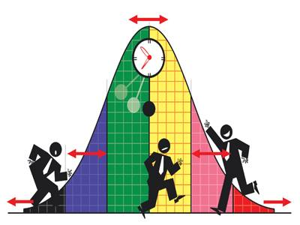
Forced Distribution System
75% to 80% companies in India use this system.
Big Indian employers including Infosys Wipro, ICICI Bank and Aditya Birla Group evaluate lakhs of employees on the basis of this system.
http://articles.economictimes.indiatimes.com/2014-06 06/news/50387617_1_performance-appraisal-bell-curve-closing-bell

Slide 31
Forced Choice Method
In this method, the evaluator has to evaluate the employees with the help of a series of statements (or list of traits).
The series may contain both favourable and unfavourable statements.
Each statement carries weights or scores which may not be known to the evaluator.
The evaluator has to choose the most appropriate statement which best represents the individual being evaluated.

Slide 32
Critical Incident Method
In this method, the supervisor is required to keep a written record of positive and negative work-related actions of the employees.
During the evaluation, these records can supplement other data effectively in evaluating the employee’s performance.
This method helps in identifying the fundamental areas in which employees are strong or weak.

Slide 33
Critical Incidents Methods
These critical incidents or events represent the outstanding or poor behavior of employees on the job
July 20 – The sales clerk patiently attended to the customers complaint. He is polite, prompt, enthusiastic in solving the customers’ problem.
On the other hand the bad critical incident may appear as under:
July 20 – The sales assistant stayed 45 minutes over on his break during the busiest part of the day. He failed to answer the store manager’s call thrice. He is lazy, negligent, stubborn and uninterested in work

Slide 34
Essay Method
In this method, the evaluator writes a short description of an employee’s performance.
This method focuses less on the employees’ regular day-to-day performance and more on their extreme behaviour at work.
The efficiency of this method depends greatly on the evaluator’s writing skills and objectivity.
However, it provides scope for manipulation by the evaluator.

Slide 35
Essay Appraisal Method
While preparing the essay on the employee, the rater considers the following factors:
Job knowledge and potential of the employee;
Employee’s understanding of the company’s programmes, policies, objectives, etc.
The employee’s relations with co-workers and superiors
The employee’s general planning, organizing and controlling ability
The attitudes and perceptions of the employee, in general.

Slide 36
Cost-benefit Method
In this method, the management evaluates the cost of retaining an employee in the organization and also the benefits accruing to it through that employee.
A cost-benefit comparison is made as part of performance evaluation to determine the real contribution of that employee to the organization.
The appearance, manners and sociability skills of the employee are some of the guidelines used for evaluating the employees.

Slide 37
Work Standard Method
In this method, the evaluator compares the performance of the employees against the standards established in the form of expected output.
The standard output is usually established on the basis of the normal performance of an average employee.
This method by and large avoids evaluator’s bias as the standards are fixed scientifically and objectively.

Slide 38
Checklist Method
In this method, a checklist containing a series of statements about the traits of the employees is presented to the evaluator.
Each statement is to be answered in ‘Yes or No’ format.
Each statement carries a score based on its importance to the overall evaluation.
After the evaluator completes the evaluation, the checklist is sent to the HR department for further processing like assigning predetermined scores, totalling such scores etc.

Slide 39
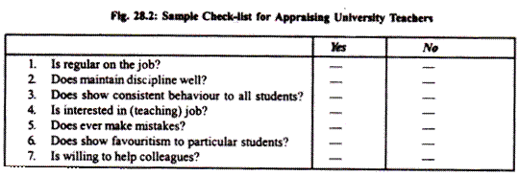
Check list

Slide 40
Field Review Method
In this method, the evaluation of an employee is done by someone other than his or her own superiors.
Normally, evaluation is done by the HR people, who scrutinize the records of those employees who are being evaluated and conduct interviews with them and their superiors.
This method facilitates inter-person comparison of the managerial personnel in different places.

Slide 41
Confidential Report
CR is a kind of evaluation practised predominantly in government and public sector organizations.
The evaluation report is prepared by the immediate superiors, usually on the basis of the continuous observation of employees over a period of time.
The CR follows a predetermined format for gathering data relating to employee’s skills, knowledge, initiative, attitude, integrity, scope for improvement, aptitude and area of concern.

Slide 42
Confidential Report System
Key factors assessed in Confidential Report writing
Character and conduct of an employee
Absenteeism of an employee
Knowledge of an employee
His nature and quality of work
Punctuality of employee
Unauthorised absenteeism or leave without permission
Behaviour of an employee with colleagues, superiors and with public
Ability of supervision and controlling
His/her integrity and honesty
If any complaints against employee

Slide 43
Result-based Evaluation System
Under the result-based system, the superior and the employees work together on setting goals for the subsequent evaluation periods.
On the basis of consensus, the employees agree to achieve the goals set for them.

Slide 44
Behaviourally Anchored Rating Scales (BARS) Method
In this method, the different performance levels of employees are shown by the side of the scale, with each level described in terms of specific behavioural example, either good or bad performance.
This method specifies the various dimensions to be rated in behavioural terms and makes use of critical incidents to explain the various levels of performance.

Slide 45
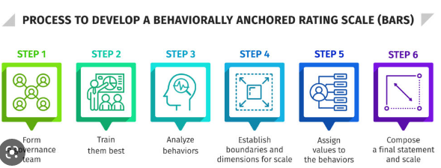


Slide 46
Steps in BARS
Developing critical incidents
Formulating performance dimensions
Reassigning the incidents
Rating the incidents
Evolving a final instrument

Slide 47
360-degree feedback
360-degree feedback is a systematic collection and feedback of performance data on an individual or group derived from a number of the stakeholders on their performance.

Slide 48
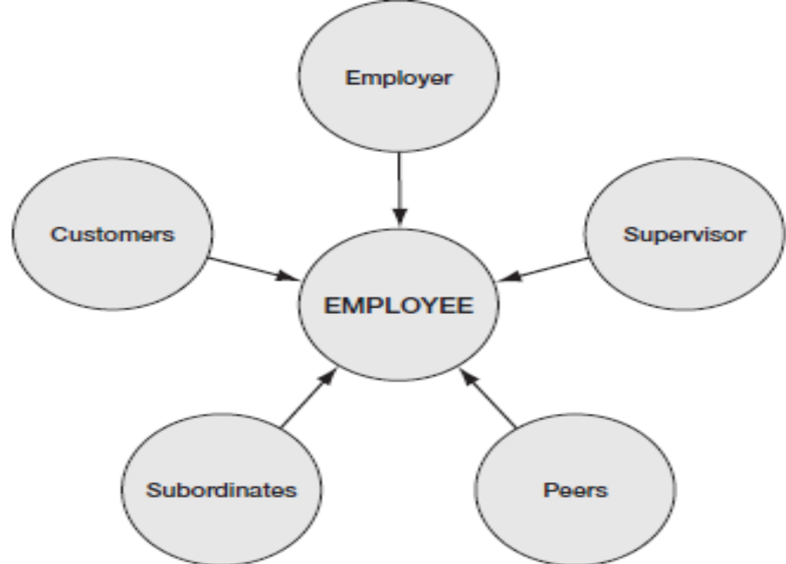
360-degree feedback

Slide 49
360-degree feedback method
In this method all those who interact with an employee in any capacity will prepare an evaluation report on him or her.
Senior managers, supervisors, employees, peers, team members, internal or external customers and even the employees themselves evaluate the performance.
360-degree feedback method aims at ensuring an objective and comprehensive evaluation of a person’s performance.

Slide 50
Steps in the development of the 360 - degree feedback method
Determining the objectives.
Deciding the receiver and giver of feedback.
Establishing the performance criteria.
Determining the mode of collecting data.
Finalizing the method of data analysis and presentation.
Trying a pilot scheme.
Execution of the feedback process.
Evaluation and communication.

Slide 51
Management by Objectives (MBO)
MBO involves setting specific measurable goals by the managers in consultation with the employees and, subsequently, examining the latter’s progress towards those goals.
MBO counts on joint goal-setting to formulate and achieve objectives for the organization, the department and the individual.
MBO enables employees to get involved in the evaluation process by setting their own goals.

Slide 52
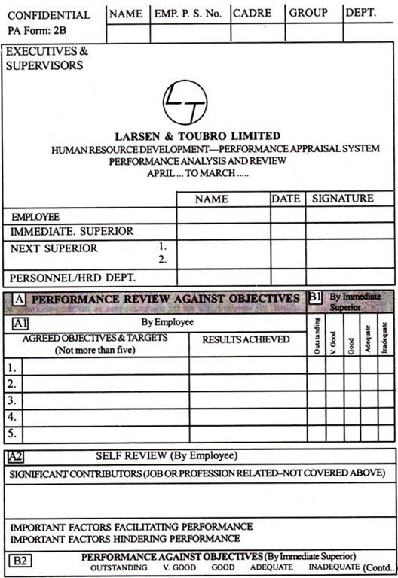
MBO

Slide 53
Steps in MBO
Projecting the goals
Discussing the goals
Developing yardsticks
Executing performance reviews
Providing feedback

Slide 55
Lecture 9
26th Nov 2022
News sharing and discussion
Dr. MRIDULA MISHRA

Slide 56
Unit 4
Performance Management System : performance management, performance planning, performance appraisal, potential appraisal, feedback and counselling
Compensation Management : types and theories of compensation, concept of wages, factors influencing compensation management, incentives and fringe benefits, employee engagement and retention

Slide 57
Learning outcomes
Students will be able to understand and learn
Compensation Management
types and theories of compensation
concept of wages
factors influencing compensation management
incentives and fringe benefits
employee engagement and retention

Slide 58
MCQs
All incentive plans focused on ………?
Performance
Skills
Tenure
particular knowledge
Notes:
A

Slide 59
MCQs
Which of the following components are reformed to support the strategies of human resource function?
Control systems
Appointment
Rewards
Job allotment
Notes:
C

Slide 60
MCQs
Which of these is an external strategy of environment?
a. Lobbying
b. Recruitment
c. Rationing
d. Buffering
Notes:
a

Slide 61
Learning outcomes
Students will be able to understand
compensation management
types and theories of compensation
concept of wages
factors influencing compensation management
incentives and fringe benefits
employee engagement and retention

Slide 62
Compensation Management

Slide 63
Important Link
https://www.youtube.com/watch?v=pqtYQb9nbRk – Compensation and Benefits
https://www.youtube.com/watch?v=2ADpXq4iQ- Managing Employee Compensation and Benefits
Uhttps://www.youtube.com/watch?v=iY6e_NDCJgM
https://www.youtube.com/watch?v=qO4aDHi6ZPo - Compensation Management Software from HR soft
http://www.paycheck.in/main

Slide 64
http://www.paycheck.in/main

Slide 65
Compensation Management
Compensation is the sum of the rewards for the job-related efforts of the employees and also for their commitment to and involvement in the job.

Slide 66
Objectives of Compensation Management
Equity in Compensation
Enhancing individual and organizational efficiency
Employee motivation and retention
Goodwill in the labour market
Adherence to laws and regulations
Controlling HR cost
Improving industrial relations

Slide 67
Types of Compensation
Direct Compensation - Direct compensation normally includes the amount payable to the employees as direct cash rewards for the work extracted from them.
Indirect Compensation - Indirect compensation includes the benefits enjoyed by the employees but paid by the organization.

Slide 68
Direct Compensation
Basic Pay
Variable Pay
Profit-sharing
Gain-sharing
Equity Plans - ESOP (Employee Stock Ownership Plan)
Indirect Compensation
Medi claim
Insurance Schemes
Leave travel Concessions
Retirement Benefits

Slide 69
Theories of Compensation
Equity Theory
Expectancy Theory
Contingency Theory
Agency Theory

Slide 70
Equity Theory
According to this theory, ensuring a fair balance between an employee’s contributions to the job and his/her rewards is critical for developing a cordial relationship between the employer and the employees.
When the rewards are greater than the employees’ job efforts, they will be satisfied and vice-versa.

Slide 71
Expectancy Theory
According to this theory, employees work hard in the job whey they are sure of a positive outcome in the form of attractive rewards from the job.
Positive expectations about the eventual job outcome creates high employee motivation in the firm and vice-versa.

Slide 72
Contingency Theory
According to this theory, different compensation strategies act equally well in different circumstances. As such, there is no one best compensation strategy available for all conditions.

Slide 73
Agency Theory
Agency theory views the employer as the principal and the managers as the agents. It helps to creating ownership interest among the managers.
This theory insists that the firms develop labour market–oriented and performance -linked contractual relationship with the managers to motivate them.

Slide 74
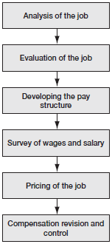
Steps in Compensation Management

Slide 75
Wages
https://www.youtube.com/watch?v=vAcaeLmybCY - If Walmart Paid Its Employees a Living Wage, How Much Would Prices Go Up?
https://www.youtube.com/watch?v=tQE0ldkiKo0- A History of The Minimum Wage
https://www.youtube.com/watch?v=0Z2pwJ8TSy0 - Employee Compensation - How To Design The Right Plan
https://www.youtube.com/watch?v=C7mC4jUU8js -Amazing Salary hike video. 100% FUNNY MBA CONCEPT
https://www.youtube.com/watch?v=FFbTnAv3Nao - Aligning Pay Structures With Job Evaluation

Slide 76
Concept of Wages
A wage is monetary remuneration paid by an employer to an employee in exchange for work done.
Payment may be calculated as a fixed amount for each task completed a task wage or piece rate, or at an hourly or daily rate, or based on an easily measured quantity of work done.

Slide 77
Types of Wages
Real Wages
Minimum Wages
Fair Wages
Living Wages

Slide 78
Concept of Wages
Real Wages - When the income earned by the employees as a reward for their job efforts is expressed in real purchasing power, it is called real wages.
Minimum Wages - This refers to the legally permissible minimum compensation payable to the employees for their job efforts.
Fair Wages- Fair wages are the wages which are usually positioned above the minimum wages but below the living wages

Slide 79
Concept of Wages
Living Wages- Highest level of wages that should enable the earner to provide for himself and his family not only the bare essentials of food, clothing and shelter but a measure of frugal comfort, including education for his children, protection against ill-health, requirements of essential social needs and a measure of insurance against the more important misfortunes, including old age.

Slide 80
Factors Influencing
External Factors
Labour Market Conditions
Labour Legislations
Comparative Pay Scales
Cost of Living
Geographical Location
Collective Bargaining
Technology
Globalization

Slide 81
Internal Factors
Capacity of the organization to pay
Corporate policies and philosophy
HR policies and strategies
Performance evaluation report

Slide 82
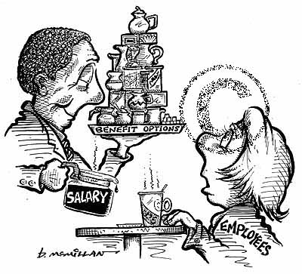
Wage in general
Fringe Benefits
- Definition
- Main types
- Legal situation
- Taxation
- Cafeteria- System
Legal differences between countries
Concequences
- for the employer
- for the employee
- for the state
Recommendations
CAFETERIA SYSTEM
possibility to combine fringe benefits
in a flexible way
the employee can choose fringe benefits
according to his needs
known in Germany, Belgium and the
Netherlands
Notes:
Defintion we discussed according to the differences from the different countries. Our result…

Slide 83
Concept
Fringe benefits are benefits which employees receive from their employment but which are not included in their salary cheque or wages.
Fringe benefits are a form of remuneration offered by the employer not strictly connected to the employee’s individual tasks.

Slide 84
Need of Fringe Benefits
Attracting Employees
Tax Benefits
Retaining Employee

Slide 85
Major types of Fringe Benefits
Company Cars
Coupons/ Vouchers
Hospitalisation Insurance
Additional Pension
Saving Schemes
Bonus
Child Care
Additional Holidays
Flexible Working Time

Slide 86
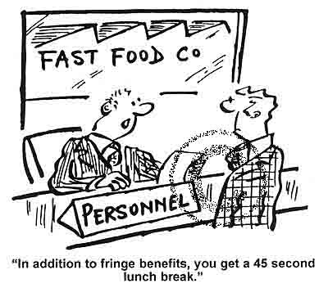
MAIN TYPES OF FRINGE BENENFITS
 | Belgium | Germany | Italy | Lithuania | Netherlands | Spain
Company cars |  | X | X | X | X
Vouchers | X | X | X | X |  | X
Hospitalisation insurance | X | X | X
Additional pension | X | X | X |  | X | X
Saving schemes |  | X | X |  | X | X
Bonus |  | X | X | X | X
Child care |  | X | X |  | X
Additional holidays |  | X | X |  |  | X
Flexible working time |  | X | X | X | X

Slide 87
Items covered under fringe benefits
As per the Finance Bill, fringe benefits shall be deemed to have been provided if the employer has incurred any expense or made any payment for the purposes of:
Entertainment
Festival celebrations
Gifts
Use of club facilities
Provision of hospitality of every kind to any person whether by way of food and beverage or in any other manner, excluding food or beverages provided to the employees in the office or factory
Maintenance of guest house
Conference
Employee welfare
Use of health club, sports and similar facilities
Sales promotion, including publicity
Conveyance, tour and travel, including foreign travel expenses
Hotel boarding and lodging
Repair, running and maintenance of motor cars

Slide 88
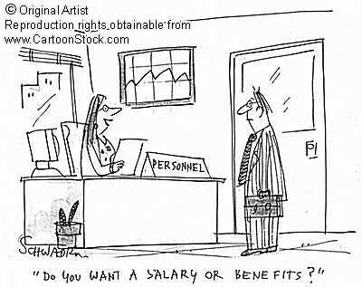
Wage in general
Fringe Benefits
- Definition
- Main types
- Legal situation
- Taxation
- Cafeteria System
Similarities
Legal differences between countries
Concequences
- for the employer
- for the employee
- for the state
Fringe benefits and Flexicurity
Recommendations
Notes:
Defintion we discussed according to the differences from the different countries. Our result…

Slide 89
Employee Engagement and Retention

Slide 90
Employees Engaged
Regularly communicate the following:
MISSION
VISION
VALUES
Why does the company exist?
What the company wants to be?
What’s important to the firm?

